Slide 1
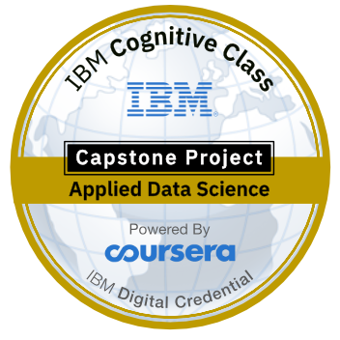
Battle of the Neighbourhoods-Asian Delicacies in Seattle
Applied Data Science Capstone
By-
Snehav sharma

Slide 2
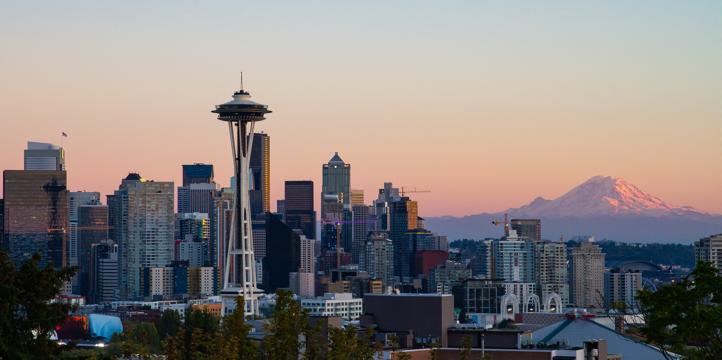
Introduction
The problem to be addressed in this project is to find out the most popular neighbourhood in the city of Seattle to open an Asian Cuisine restaurant that would help the businessmen to make an informed decision.

Slide 3
Data requirements
To find the solution to our business problem it is imperative that we have plenty of data to analyse and recommend the optimal location for an Asian restaurant.
To analyse and come up with a solution, we firstly need the latitudes and longitudes for all the neighbourhoods of the city of Seattle.
Next we would find the restaurants that are there within a radius of around 500 feet of those location in order to establish similarity between the neighbourhoods.

Slide 4
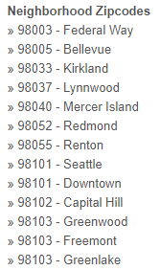
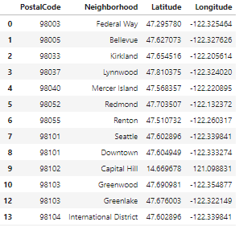
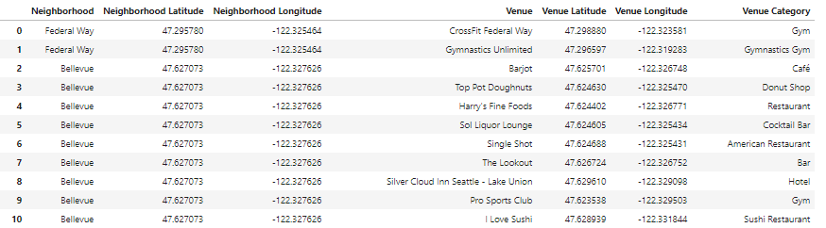
Data collection
Seattlearea.com Geopy Library Foursquare API

Slide 5
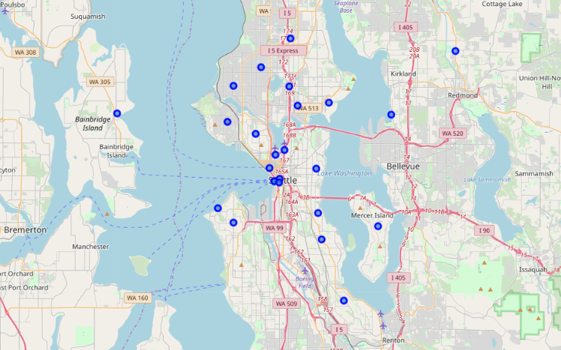
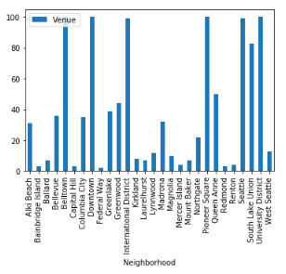
Methodology
Exploratory Analysis

Slide 6
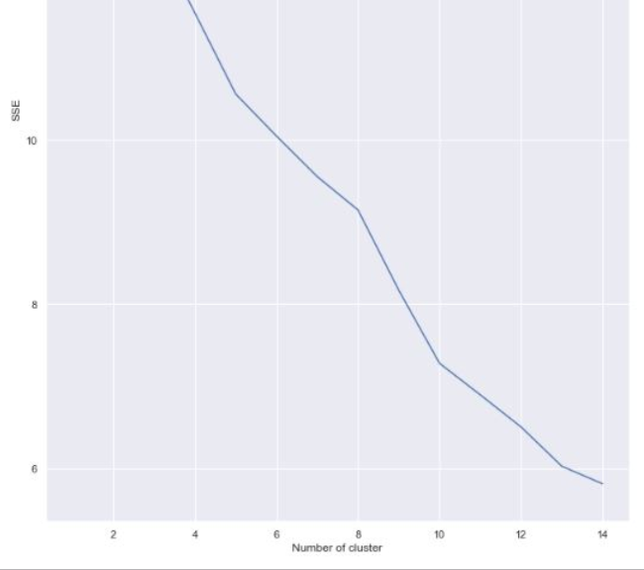
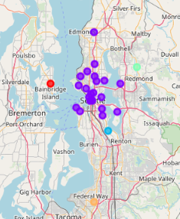
Cluster analysis
K=5 using the following elbow graph – Resulted in 4 clusters

Slide 7
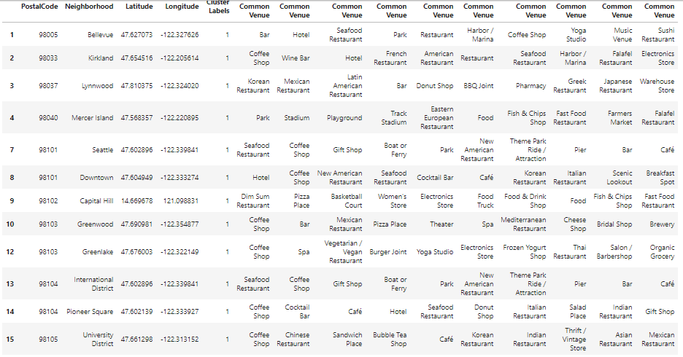
Results and conclusions
The result of the project was that if businessman wants to open an Asian restaurant in the city of Seattle, the optimal location for that is the neighbourhood of University district due to the fact that it was in the cluster having number of Asian restaurants and had the most number of Asian Restaurants in its top 10 most common venue list.
It seems reasonable as there seems a large cluster of international students and population in that area.
Therefore, that might be the reason for them to have the most number of popular venues too due to a majority of youth population in that area.

Slide 8
Thank you

